Slide 1
CodeU’s
Bootcamp
Chapter 2
Welcome to your 6th session!
The class will start shortly...
Reproduction and distribution of the presentation deck is prohibited

Slide 2
Agenda for today’s class
Kahoot!
01
02
Homework correction
To recap what was seen last class!
Let’s correct last week’s homework!
Topic of the day:
03
04
Practice time!
-For Loop exercises
Let’s practice with some coding exercises!
Wrap-up
Conclusion
05
06
CodeU Robot
Summary of what we’ve learned today.
Homework and questions.

Slide 3

Time for Kahoot!
Head over to Kahoot.it for a fun coding quiz!

Slide 4

Homework Solution: Will the elevator break?
# Build the list of tourists
weight = [208, 200, 350, 500, 127, 145, 134, 900]
# Number of tourists
participants = len(weight)
# Create the variable where you will be adding the weight of every person
weight_total = 0
# Create the FOR Loop
for i in weight:
weight_total += i
# Print the results
print(str(participants) + " participants weigh a total of " + str(weight_total))
This Photo by Unknown Author is licensed under CC BY-SA-NC

Slide 5

CodeU Amusement Park!
01
You’ve been hired by the CodeU Amusement Park to help them out with an issue. They’ve given you a list of people’s heights and asked you to determine how many people there are, and how many are allowed to ride the rollercoasters. The height requirement is 140 cm. Help them out by building a code that will give them the answers they are looking for!
Here is the list of people and their heights:
heights = [208, 200, 137, 141, 127, 145, 134, 250, 190, 133, 127, 201, 206, 142, 147, 115, 187, 178, 170, 175]
You must create a variable for the number of people over 140 cm and a variable for the total number of people (Hint: The total number of people can be found using a List Manipulation technique).
You then have to create a FOR Loop that navigates through the heights in the list.
Inside the Loop, create a conditional where if the height is greater or equal to 140, 1 is added to the variable that determines the count.
Print() the results.

Slide 6
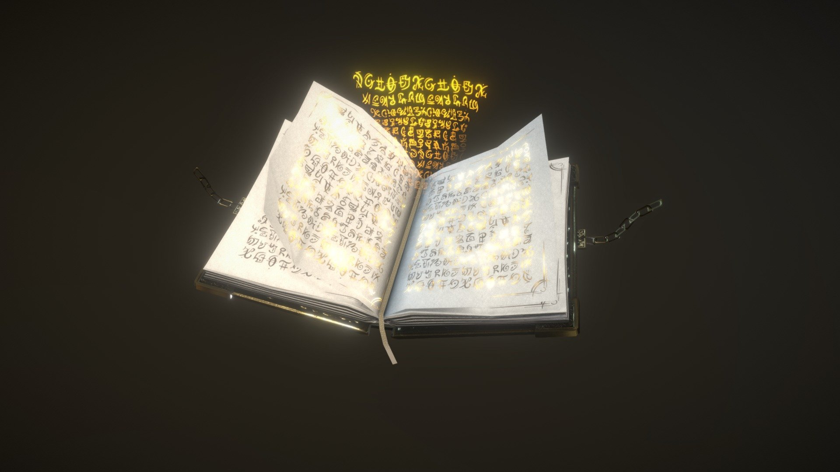
How many a’s are there?
LEVEL: EASY
Description
You are given the word ABRACADABRA and you must determine the exact number of a’s in that word.
Create a variable containing the requested String
Create another variable that will count the number of a’s.
You will then create a FOR Loop that navigates through the variable of the string.
Inside the Loop, create a conditional where each time the FOR Loop reads an ‘’a’’, 1 is added to the variable that determines the count.
Print() the result.

Slide 7

How many a’s are there?
LEVEL: HARD
Description
You are given a LIST of several words. You must determine the amount of a’s in the ENTIRE List.
Create a variable containing the LIST.
Create another variable that will count the number of a’s.
You will then create a FOR Loop that navigates through the LIST variable.
Inside the Loop, you will create a New FOR Loop that navigates through the word retrieved by the initial Loop. We call this a NESTED LOOP.
Inside the Nested Loop, create a conditional where each time the FOR Loop reads an ‘’a’’, 1 is added to the variable that determines the count.
Print() the result.
This Photo by Unknown Author is licensed under CC BY-NC-ND

Slide 8

Homework: Aliens?
Homework Description
The CIA is currently investigation a TOP SECRET case. There is a remote island in the Caribbean that they think is very suspicious. Using satellites and radio, they're able to pick up weird and unusual signals.
They decide to send in a spy to scout the area and see what's going on. As she explores the island, she spots a weird moving shape from the distance. She gets closer and sees that it's...aliens!
As soon as she realizes, she runs away to hide while calling the CIA to let them know. However, as she was running, she dropped the cellphone in a puddle. She was only able to let them know that there are aliens, but not how many there were. She remembered seeing a radio near where the aliens were stationed. So, at night, she decided to infiltrate their camp to use their radio to communicate with the CIA.
Unfortunately, she could only communicate using different sequences of binary code (1101, 010, 0011, ...). It's common knowledge at the CIA that all 1's represent an enemy.
It is your duty to decrypt this message and determine how many aliens are currently on the island!
Here is the encrypted message:
encryptedMessage = ["110010", "00000011", "10101", "111111110", "00110011010101010", "110100110110101", "110011100011110000"]
1
Create a variable that will contain the amount of aliens. This will be your “alien counter”.
Create a Loop that navigates the encrypted message. Inside this loop, you will the create a Nested Loop to navigate the index/string retrieved by the initial loop.
2
3
Inside the Nested Loop, create an IF condition that only accepts “1”. If the condition is filled, add 1 to your alien counter.

Slide 9




Thank you!
Does anyone have any questions?
Next class: Class 7
Please contact us if you have any questions or if you want to notify us for anything.
Phone:
(438) 391-9106
Email:
hello@codeu.ca

